Slide 1
Text Summarization Tasks and Evaluation Metrics
Alex Fabbri
10-20-2020

Slide 2
Outline
Introduction to text summarization and tasks
Three main papers
Neural Text Summarization: A Critical Evaluation
SummEval: Re-evaluating Summarization Evaluation
On Faithfulness and Factuality in Abstractive Summarization
Concluding thoughts and discussion questions

Slide 3
What is summarization?
Text summarization is the process of distilling the most important information from a source (or sources) to produce an abridged version for a particular user (or users) and task (or tasks).
Mani and Maybury, 1999

Slide 4
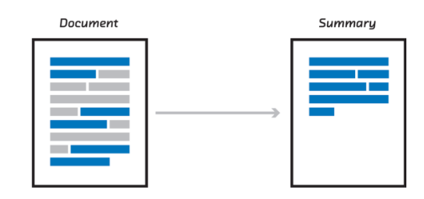
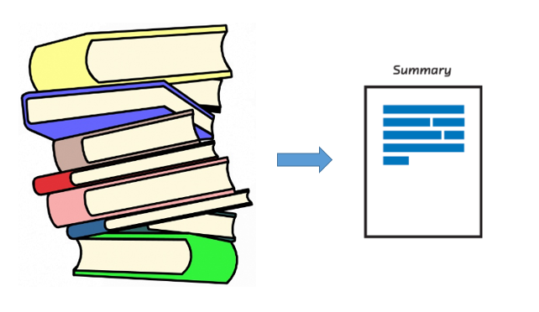
Types of summarization: input
Single-document summarization
Multi-document summarization
Images: http://bit.ly/2UCBnPj http://bit.ly/2VEK1cr

Slide 5
Types of summarization: genre and data
News
CNN/Daily Mail
New York Times
XSum
Newsroom
DUC (MDS)
TAC (MDS)
Gigaword
Multi-News (MDS)
Social Media
Reddit tifu
Reddit TLDR
Live blog corpus
Scientific
Arxiv/Pubmed
Scisumm
Meetings
AMI Meetings
ICSI (data for both)
Book/stories
CMU book summaries
Character descriptions
ROC stories
Wikipedia
WikiHow
WikiSum (MDS)
Legal
BillSum
BigPatent
Court cases
Email
AESLC
BC3
Review/opinion
Yelp
Opinosis

Slide 6



Types of summarization: output style
Extractive
Abstractive
Grammatical, factual outputs
Easier task, but often lacks flow
How humans summarize
Harder task, thus brittle systems
Hybrid
Extract and rewrite
Images: http://www.abigailsee.com/2017/04/16/taming-rnns-for-better-summarization.html; https://www.yeahwrite.org/wp-content/uploads/rewrite21.jpg

Slide 7
Traditional approaches
MMR (Carbonell and Goldstein, 1998)
Balances relevance and novelty in relation to current output
Submodularity (Lin and Bilmes, 2011)
MMR is submodular; ROUGE-N is monotone submodular
Determinantal Point Processes (Kulesza and Taskar, 2011, 2012)
Capture negative correlations, diversity
Graph-based methods (Textrank: Mihalcea and Tarau, 2004; Lexrank: Erkan and Radev, 2004)
Define edges between words/sentences and use centrality to output summaries

Slide 8
Recent (neural) approaches
Abstractive
Chopra et al., 2016
Nallapati et al., 2016a
See et al., 2017
Paulus et al., 2017
Cohan et al., 2018
Celikyilmaz et al., 2018
Liu et al., 2019
Dong et al., 2019
Song et al., 2019
Raffel et al., 2019 (T5)
Lewis et al., 2019 (BART)
Zhang et al., 2020 (Pegasus)
Extractive
Nallapati et al., 2016b
Cheng et al., 2016
Narayan et al., 2018
Kedzie et al., 2018
Dong et al., 2018
Zhong et al., 2019
Zhang et al., 2019
Liu 2019
Hybrid
Liu et al., 2018
Hsu et al., 2018
Gehrmann et al., 2018
Chen and Bansal, 2018
Yao et al., 2020
MDS
Yasunaga et al., 2017
Zhang et al., 2018
Baumel et al., 2018
Lebanoff et al., 2018
Liu et al., 2018
Chu and Liu, 2019
Fabbri et al., 2019
Liu et al., 2019
Perez-Beltrachini et al., 2019

Slide 9
Typical Summarization Model in 2020
Find your favorite pretrained model which was pretrained with both an encoder and decoder (e.g. BART, T5, Pegasus)
Also applicable for decoder-only models (GPT family) or encoder-only models (just initialize the encoder and decoder with the pretrained encoder parameters and finetune from there)
Fine-tune the model on your supervised data
Get SOTA!

Slide 10
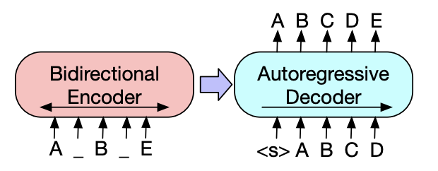
Typical Summarization Model in 2020: BART
Lewis et al., 2019
Pretrain both encoder and decoder using denoising autoencoder
This allows for more natural fine-tuning on generation tasks while also performing well on NLU tasks

Slide 11
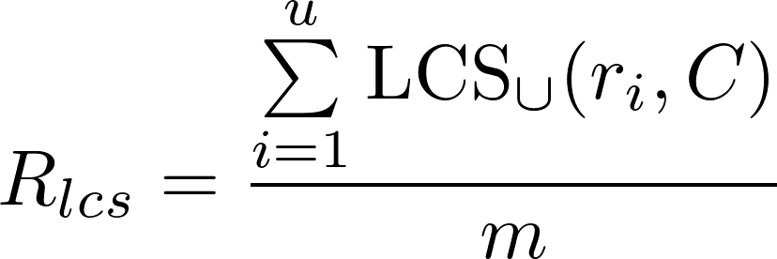
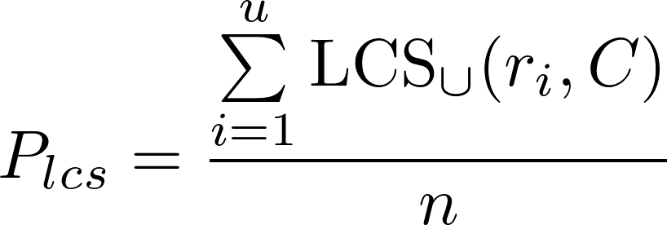
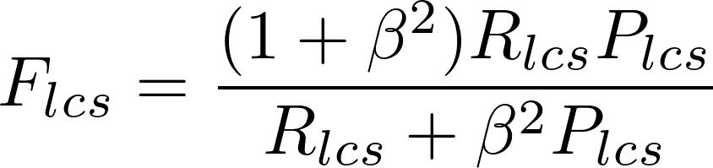
Main evaluation metric: ROUGE (Lin, 2004)
ROUGE-N: n-gram recall
ROUGE-L: longest common subsequence-based

Slide 12
Other proposed metrics (more on this later)
Meteor: Metric for Evaluation of Translation with Explicit Ordering (Satanjeev and Lavie, 2005)
Harmonic mean of unigram recall and precision, with greater weight on recall
Pyramid (Nenkova and Passonneau, 2004)
Overlap in semantic content units
CIDEr: Consensus-based Image Description Evaluation (Vedantam et al., 2015)
tf-idf weighted n-gram similarity
ROUGE-WE: Better Summarization Evaluation with Word Embeddings for ROUGE (Ng and Abrecht, 2015)
ROUGE 2.0: considers synonym dictionaries to compute token overlap(Ganesan 2018)
ROUGE-G: A graph-theoretic summary evaluation for rouge (ShafieiBavani et al., 2018)
SERA: Summarization Evaluation by Relevance Analysis (Cohan and Goharian, 2016)
Compares overlap in retrieval results using generated and gold summaries as queries
Fact-based:
Assessing The Factual Accuracy of Generated Text (Goodrich et al., 2019)
Evaluating the Factual Consistency of Abstractive Text Summarization (Kryściński et al., 2019)

Slide 13
Human-based evaluation
1-5 scale rating
Grammaticality, Non-redundancy, Referential clarity, Focus, Structure and Coherence
Best-worst scaling (Louviere et al., 1991, 2015)
Shown two summaries; pick one as best; shown to be more reliable than rating scales (Kiritchenko and Mohammad, 2017)
Question-answering evaluation
Compare the number of questions which can be answered from summaries across models

Slide 14
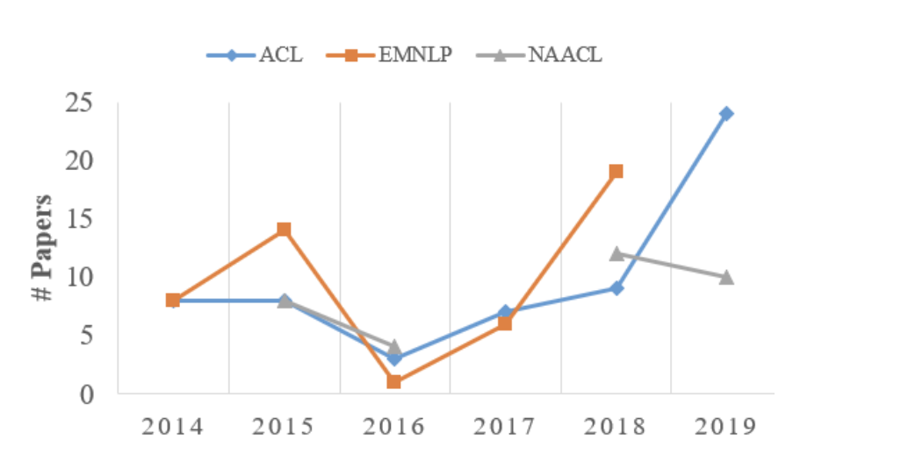
Summarization's growing popularity
http://pfliu.com/pl-summarization/summ_paper.html
http://pfliu.com/Historiography/summarization/summ-eng.html

Slide 15
Important research directions
Understanding the corpora we use, their characteristics and generalization within summarization
A Repository of Corpora for Summarization
A need to better frame the summarization problem
Neural Text Summarization: A Critical Evaluation
Understanding and improving evaluation metrics
SummEval: Re-evaluating Summarization Evaluation
Faithfulness for useable summarization models
On Faithfulness and Factuality in Abstractive Summarization

Slide 16
A Repository of Corpora for Summarization
Franck Dernoncourt, Mohammad Ghassemi, Walter Chang
LREC 2018

Slide 17
Understanding Summarization Corpora
Many summarization corpora available to train a model
However, even within the same domain, large variations in characteristics of the data
We need to understand these characteristics to build models which generalize beyond a single domain

Slide 18
Summarization subaspects
A summary can be viewed as a function of several subfunctions (subaspects) such as position, importance, diversity
For example, position is very important in news summaries, as the most important information is typically found in the first several sentences
By understanding the subaspects found in datasets and model outputs, we can better understand the biases of our models

Slide 19
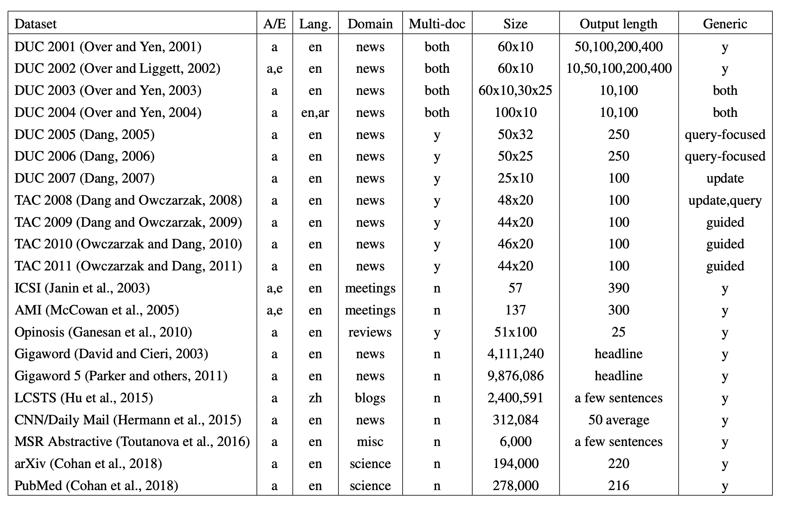
Variations in current datasets

Slide 20
Conclusions
We need to be more mindful about the characteristics of our datasets, as these are learned by the models trained on them
Interesting recent dataset analyses
Earlier Isn’t Always Better: Sub-aspect Analysis on Corpus and System Biases in Summarization
Corpora Evaluation and System Bias Detection in Multi-document Summarization

Slide 21
Neural Text Summarization: A Critical Evaluation
Wojciech Kryściński, Nitish Shirish Keskar, Bryan McCann, Caiming Xiong, Richard Socher
EMNLP 2019

Slide 22
Motivation & Contributions
Despite much recent work, state-of-the-art models (at the time) only slightly outperform the Lead-3 baseline
The paper attributes this to problems in dataset collection and evaluation
The paper provides an analysis of faults in current datasets and the dataset collection process as well as the main evaluation metric ROUGE

Slide 23
Unconstrained dataset collection
Most summarization datasets are of the format (input document, reference summary)
This leaves much room for ambiguity when collecting such datasets
The paper compares this unconstrained problem to the constrained problem (input document, summary questions, reference summary) where the reference summary takes into account the summary questions

Slide 24
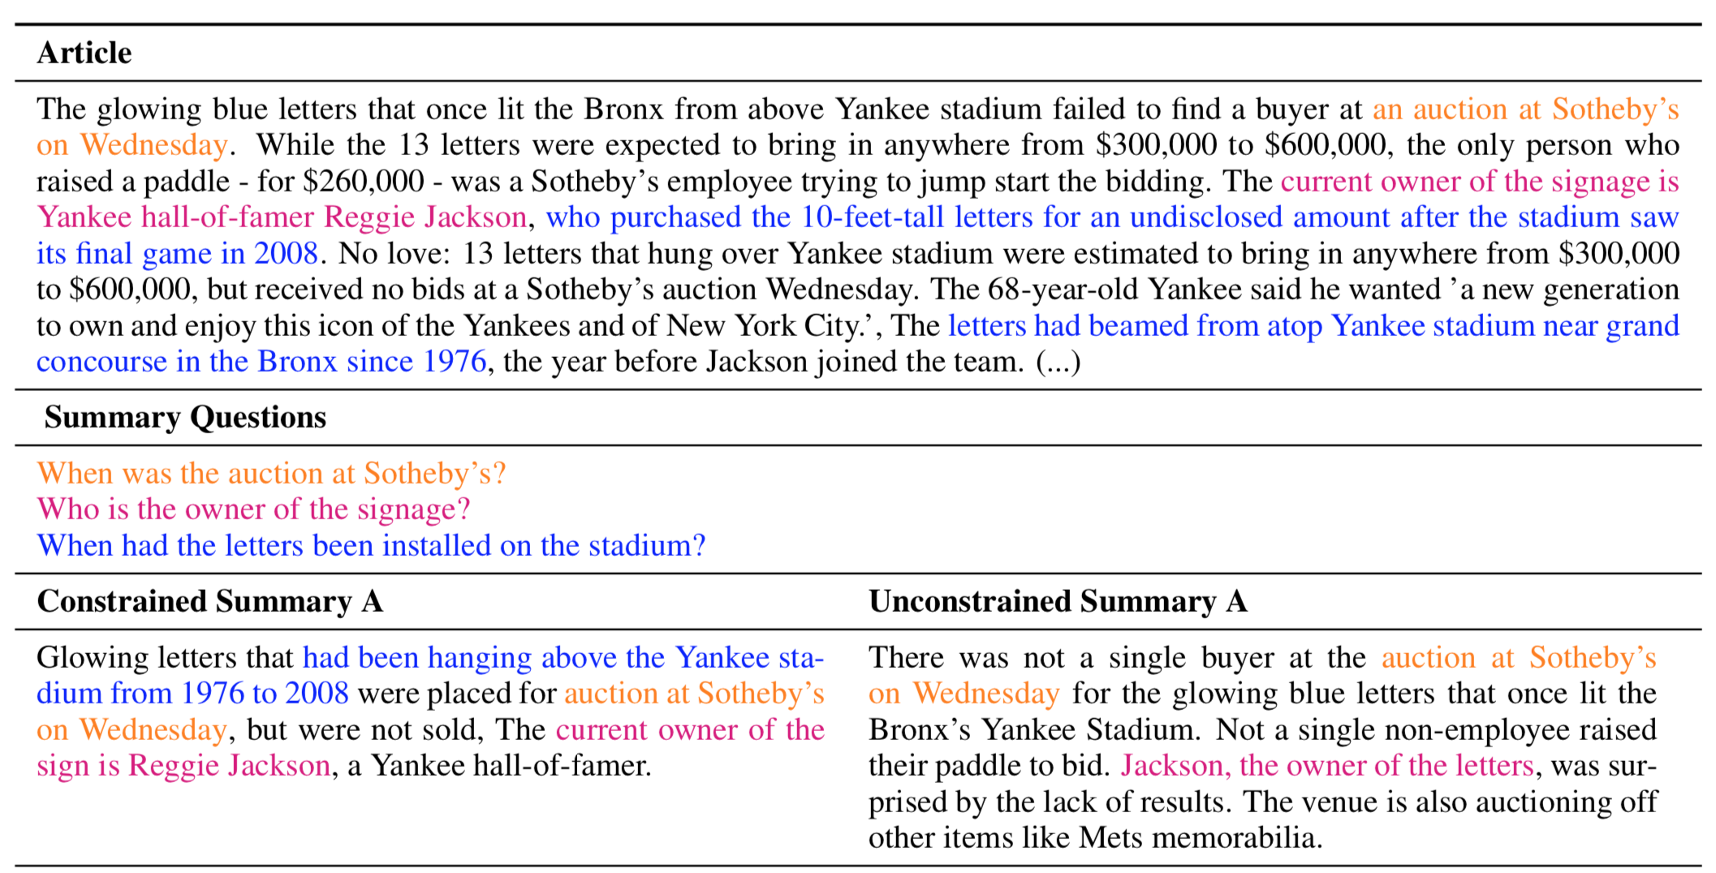
Unconstrained vs. constrained summarization

Slide 25
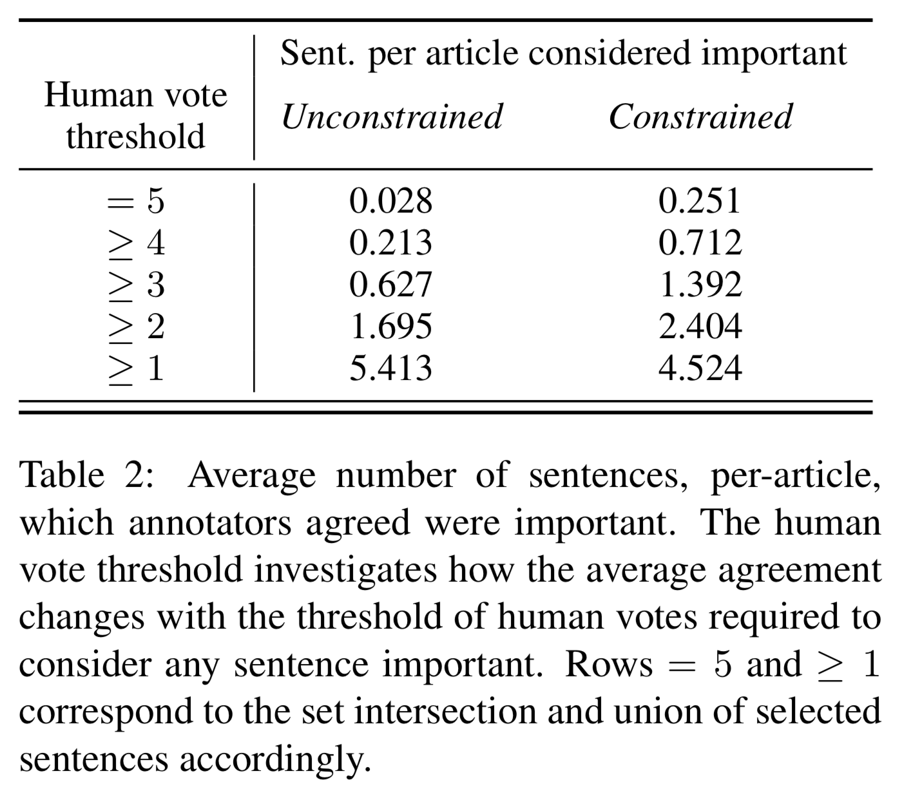
Unconstrained vs. constrained summarization cont.

Slide 26
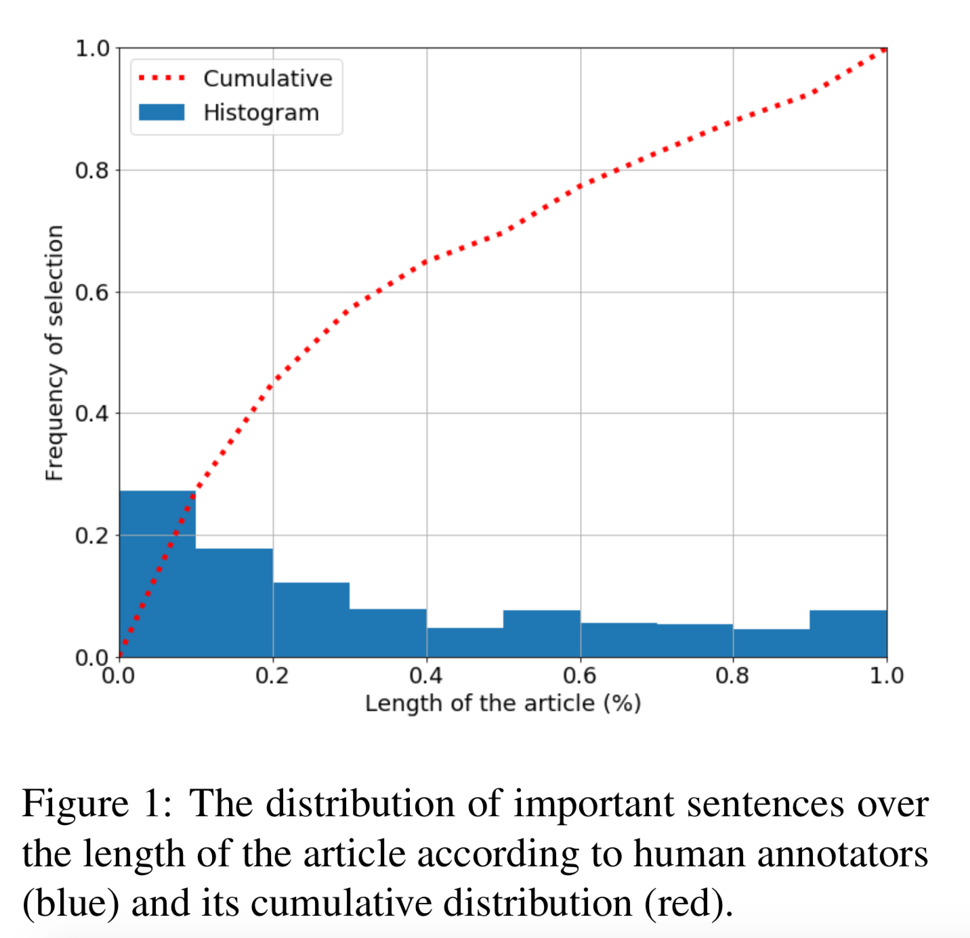
Bias in news data
Well-known that first sentences of a news article contain the most salient information
This bias is not present in many other domains
Several papers have also noticed and started to address this problem
Countering the Effects of Lead Bias in News Summarization via Multi-Stage Training and Auxiliary Losses
Content Selection in Deep Learning Models of Summarization
Searching for Effective Neural Extractive Summarization: What Works and What’s Next

Slide 27
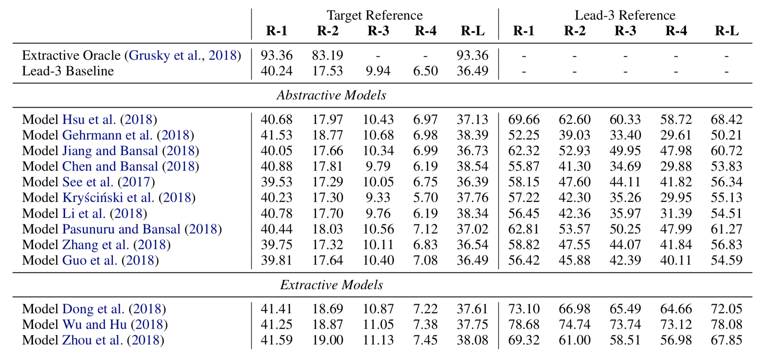
Bias in news data learned by models

Slide 28
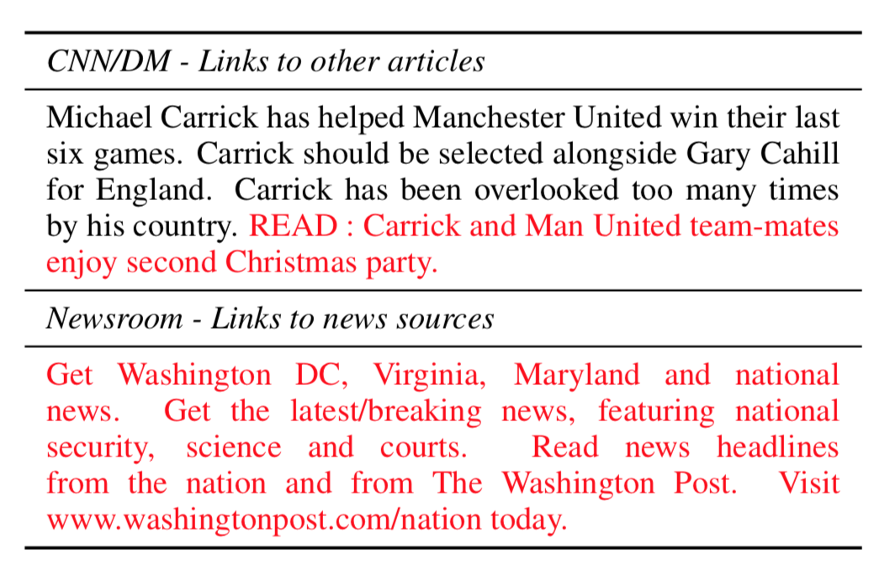
Noisy data collection
Data scraped automatically without additional checks may contain noise in both the input document and summary

Slide 29
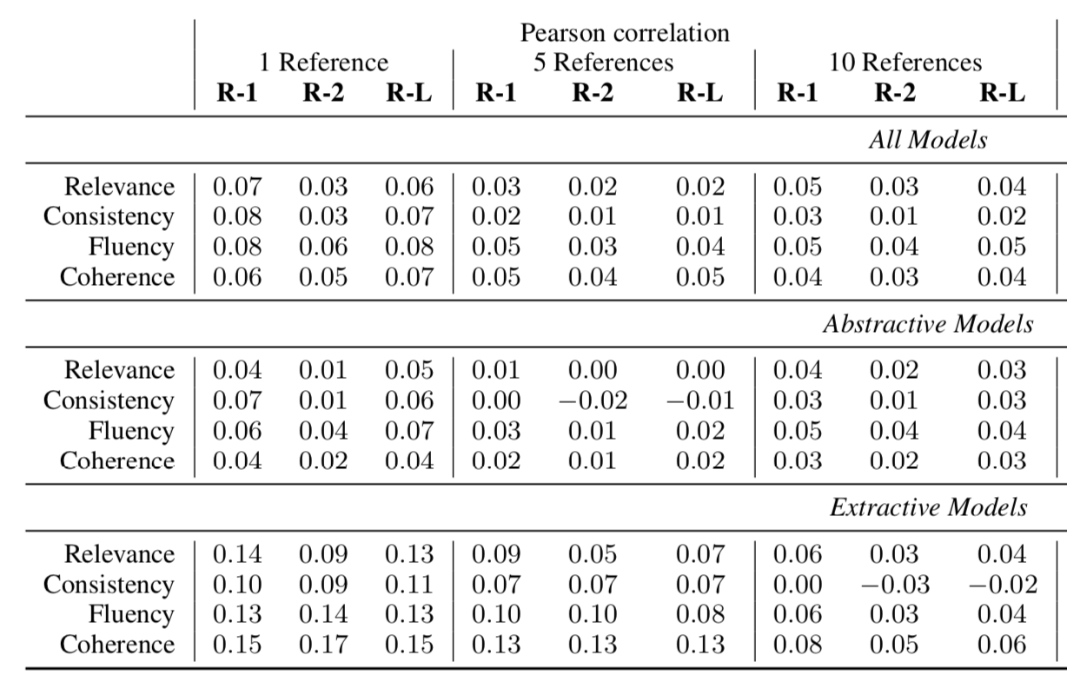
Evaluation
Weak correlation with human judgement
13 summarization system outputs over 100 articles
Ask human annotators to rate summaries across relevance, consistency, fluency and coherence
Lack of factual evaluation
60/200 article-summary pairs analyzed contained some kind of factual incorrectness

Slide 30
Conclusions
As discussed earlier, we need to be careful about the data we use and how we frame the problem of summarization
Many problems exist with the default evaluation setup, notably, a gap in factual evaluation (more on this later)
Recent work and shift in focus offer hope
HIGHRES: Highlight-based Reference-less Evaluation of Summarization
Studying Summarization Evaluation Metrics in the Appropriate Scoring Range
Evaluating the Factual Consistency of Abstractive Text Summarization
Assessing The Factual Accuracy of Generated Text
Best practices for the human evaluation of automatically generated text

Slide 31
SummEval: Re-evaluating Summarization Evaluation
Alexander R. Fabbri, Wojciech Kryściński, Bryan McCann, Caiming Xiong, Richard Socher, Dragomir Radev
TACL 2020 (accepted with revisions)

Slide 32
Motivation & Contributions
There is a lack of comprehensive up-to-date studies on evaluation metrics for text summarization and a lack of consensus regarding evaluation protocols
We reevaluate 12 automatic evaluation metrics and release a toolkit to access these metrics
We benchmark 23 recent summarization models using these metrics
We assemble the largest collection of summaries generated by models trained on the CNN-DailyMail dataset and largest collection of human model judgments on this dataset

Slide 33
Evaluation Metrics
ROUGE - (Lin, 2004b) token overal
ROUGE-WE (Ng and Abrecht, 2015) extends ROUGE by using soft lexical matching based on the cosine similarity of Word2Vec (Mikolov et al., 2013) embeddings.
S3 (Peyrard et al., 2017) is a model-based metric that uses previously proposed evaluation metrics, such as ROUGE, JS-divergence, and ROUGEWE, as input features for predicting the evaluation score.
Bert-Score (Zhang* et al., 2020) computes similarity scores by aligning generated and reference summaries on a token-level.
MoverScore (Zhao et al., 2019) measures semantic distance between a summary and reference text by making use of the Word Mover’s Distance (Kusner et al., 2015)
Sentence Mover’s Similarity (SMS) (Clark et al., 2019) extends Word Mover’s Distance to view documents as a bag of sentence embeddings
SummaQA (Scialom et al., 2019) applies a BERT-based question-answering model to answer cloze-style questions using generated summaries.
BLEU (Papineni et al., 2002) is a corpus-level precision-focused metric which calculates n-gram overlap
CHRF (Popovic, 2015) calculates character-based n-gram overlap between model outputs and reference documents.
METEOR (Lavie and Agarwal, 2007) computes an alignment between candidate and reference sentences using stemming, synonyms and paraphrastic matches
CIDEr (Vedantam et al., 2015) computes {1-4}- gram co-occurrences between the candidate and reference texts
Data Statistics: Grusky et al. (2018) define measures of the extractiveness of a dataset such as coverage and density

Slide 34
Extractive Summarization Models
M1 - NEUSUM (Zhou et al., 2018) jointly scores and selects sentences by first building a hierarchical representation of a document and considering the partially outputted summary at each time step.
M2 - BanditSum (Dong et al., 2018) treats extractive summarization as a contextual bandit problem where the document is the context and the sequence of sentences to include in the summary is the action.
M3 - LATENT (Zhang et al., 2018b) propose a latent variable extractive model which views revance labels of sentences in a document as binary latent variables
M4 - REFRESH (Narayan et al., 2018) propose using REINFORCE (Williams, 1992) to extract summaries, approximating the search space during training by limiting to combinations of individually high-scoring sentences.
M5 - RNES (Wu and Hu, 2018) propose a coherence model to capture cross-sentence coherence, combining output from the coherence model and ROUGE scores as a reward in a REINFORCE framework.
M6 - JECS (Xu and Durrett, 2019) first extracts sentences from a document and then scores possible constituency-based compressed units to produce the final compressed summary.
M7 - STRASS (Bouscarrat et al., 2019) extracts a summary by selecting the sentences with the closest embeddings to the document embedding, learning a transformation to maximize the similarity between the summary and the ground truth

Slide 35
Abstractive Summarization Models
M8 - Pointer Generator (See et al., 2017) propose a variation of encoder-decoder models, the Pointer Generator Network, where the decoder can choose to generate a word from the vocabulary or copy a word from the input. A coverage mechanism is also proposed to prevent from repeatedly attending to the same part of the source document.
M9 - Fast-abs-rl (Chen and Bansal, 2018) propose a model which first extracts salient sentences with a Pointer Network and rewrites these sentences with a Pointer Generator Network. In addition to maximum likelihood training a ROUGE-L reward is used to update the extractor via REINFORCE (Williams, 1992).
M10 - Bottom-Up (Gehrmann et al., 2018) introduce a bottom-up approach whereby a content selection model restricts the copy attention distribution of a pretrained Pointer Generator Network during inference.
M11 - Improve-abs (Kryscinski et al., 2018) extend the model of Paulus et al. (2017) by augmenting the decoder with an external LSTM language model and add a novelty RL-based objective during training.
M12 - Unified-ext-abs (Hsu et al., 2018) propose to use the probability output of an extractive model as sentence-level attention to modify word-level attention scores of an abstractive model, introducing an inconsistency loss to encourage consistency between these two levels of attention.
M13 - ROUGESal (Pasunuru and Bansal, 2018) propose a keyphrase-based salience reward as well as an entailment-based reward in addition to using a ROUGE-based reward in a REINFORCE setting, optimizing rewards simultaneously in alternate mini-batches.
M14 - Multi-task (Ent + QG ) (Guo et al., 2018) propose question generation and entailment generation as auxiliary tasks in a multi-task framework along with a corresponding multi-task architecture.

Slide 36
Abstractive Summarization Models cont.
M15 - Closed book decoder (Jiang and Bansal, 2018) build upon a Pointer Generator Network by adding an additional copy-less and attention-less decoder during training time to force the encoder to be more selective in encoding salient content.
M16 - SENECA (Sharma et al., 2019) propose to use entity-aware content selection module and an abstractive generation module to generate the final summary.
M17 - T5 (Raffel et al., 2019) perform a systematic study of transfer learning techniques and apply their insights to a set of tasks all framed as text-input to text-output generation tasks, including summarization.
M18 - NeuralTD (Böhm et al., 2019) learn a reward function from 2,500 human judgments which is used in a reinforcement learning setting.
M19 - BertSum-abs (Liu and Lapata, 2019) introduce a novel document-level encoder on top of BERT (Devlin et al., 2019), over which they introduce both an extractive and an abstractive model.
M20 - GPT-2 (Ziegler et al., 2019) build off of GPT-2 (Radford et al., 2019) and fine-tune the model by using human labels of which of four sampled summaries is the best to direct fine-tuning in a reinforcement learning framework.
M21 - UniLM (Dong et al., 2019) introduce a model pretrained on three language modeling tasks: unidirectional, bidirectional, and sequenceto-sequence prediction. It is thus applicable to natural language understanding tasks and generation tasks such as abstractive summarization.
M22 - BART (Lewis et al., 2019) introduce a denoising autoencoder for pretraining sequence to sequence tasks which is applicable to both natural language understanding and generation tasks.
M23 - Pegasus (Zhang et al., 2019a) introduce a model pretrained with a novel objective function designed for summarization by which important sentences are removed from an input document and then generated from the remaining sentences.

Slide 37
Human Annotations
3 expert annotators, 5 Amazon Mechanical Turkers
Judge summaries from 100 articles, 16 models across 4 dimensions
Coherence - the collective quality of all sentences.
Consistency - the factual alignment between the summary and the summarized source.
Fluency - the quality of individual sentences.
Relevance - selection of important content from the source.

Slide 38
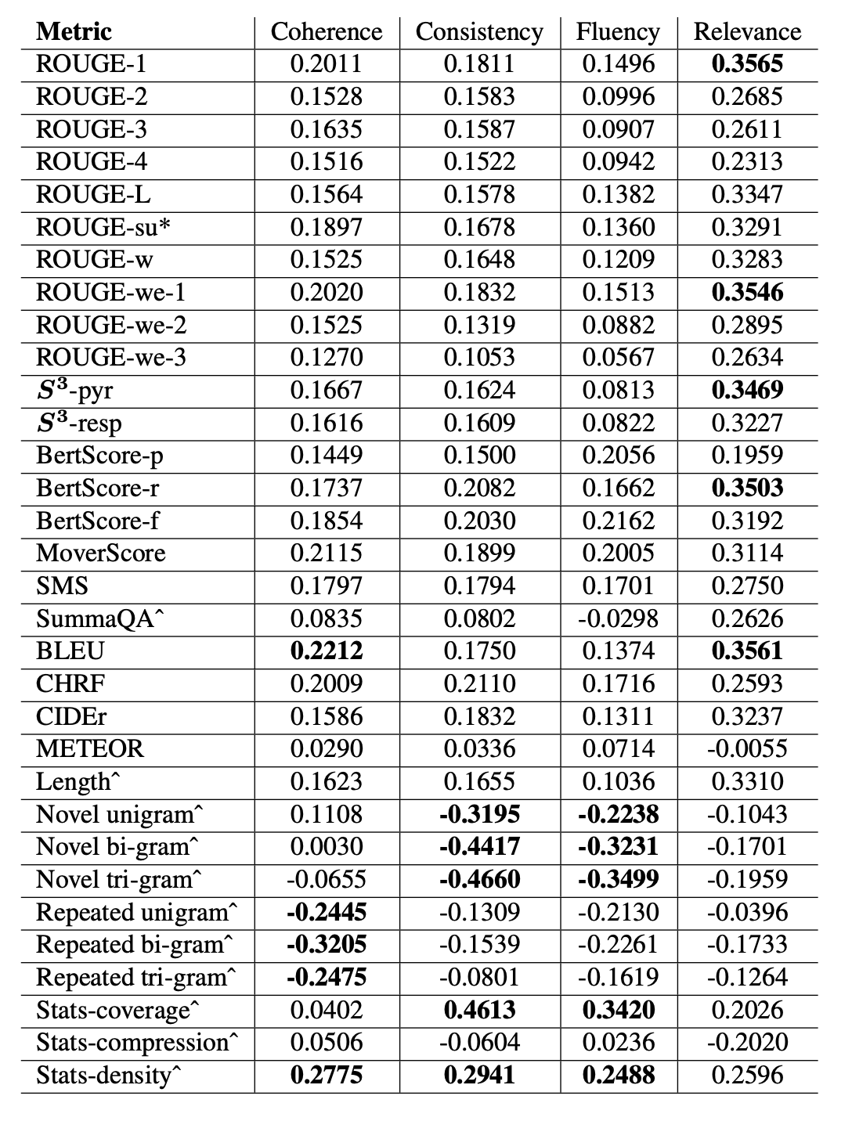
Metric Evaluation
Pearson correlations of metrics with quality dimension shown on the right
ROUGE, BLEU and BertScore perform best for relevance
Metrics perform poorly on the other dimensions
Dataset statistics correlate the most with consistency, other dimension

Slide 39
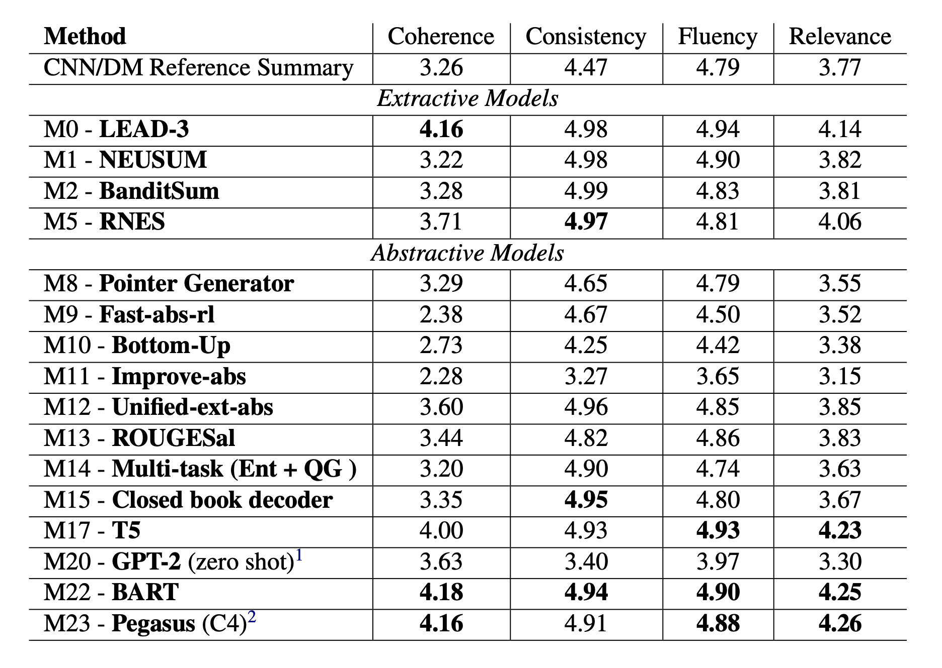
Model Evaluation
Which models perform best according to our human evaluation (using expert annotations)
Interesting finding regarding the reference summaries
Pretrained models for the win!

Slide 40
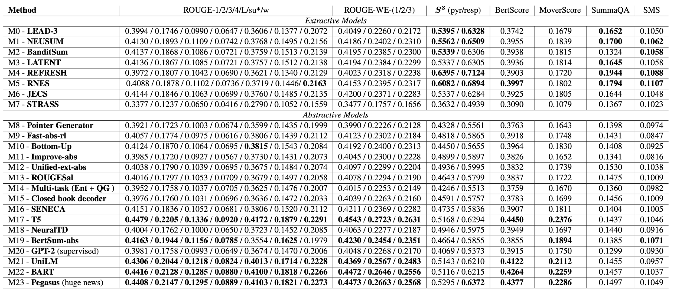
Model Evaluation cont.

Slide 41
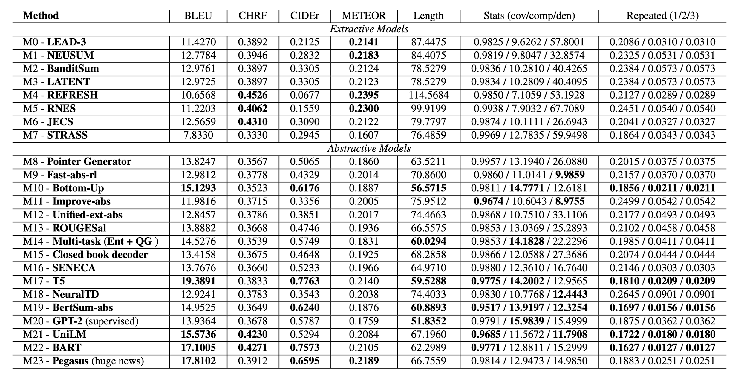
Model Evaluation cont. cont.

Slide 42
Conclusions
In order to move the summarization field forward, we need to more precisely compare evaluation metrics and models
In this work, we take a step towards that goal by analyzing current metrics and model outputs, releasing the model outputs and human judgments, along with our toolkit, to improve summarization evaluation
Check out the toolkit!
https://github.com/Yale-LILY/SummEval
Re-evaluating Evaluation in Text Summarization
Very similar work accepted to EMNLP 2020; also collect human judgments on CNNDM dataset but different dimensions, metrics;

Slide 43
On Faithfulness and Factuality in Abstractive Summarization
Joshua Maynez, Shashi Narayan, Bernd Bohnet, Ryan McDonald
ACL 2020

Slide 44
Motivation & Contributions
Abstractive summarization models suffer from hallucinations, making up content not found in the source
This paper conducts a large scale human evaluation of several abstractive models to understand the types of hallucinations found in their output
Show the usefulness of entailment as a measure of faithfulness

Slide 45
Background: XSum dataset
XSum (Narayan et al., 2018) consists of BBC news articles and 1-sentence summaries
A well-known characteristic of this dataset is that information found in the summary isn't always found in the source document since the summary is the article introduction sentence
It is a common dataset for studying hallucinations as models trained on this dataset tend to hallucinate more often

Slide 46
Classification of hallucinations
Intrinsic hallucinations
A misrepresentation of information found in the document
For example, a summary of an article on the election says that X won the election while the article says that Y won the election
Extrinsic hallucinations
The model introduces information not found in source
Note that the information may still be factual

Slide 47
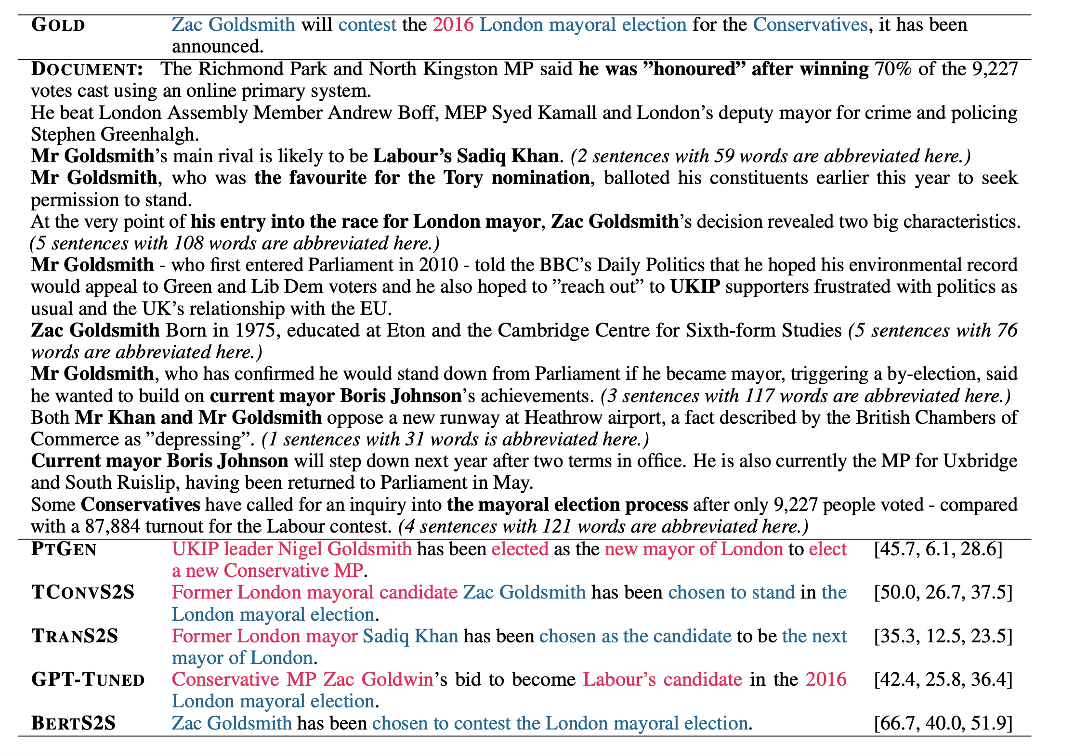
Example Hallucinations
Example gold summary, document and model outputs shown, with hallucinations highlighted in red, good faithful summary components in blue
Note the date 2016 not found in the source text
Fewer hallucinations as we go to pretrained models

Slide 48
Models studied
RNN-based Seq2Seq
Pointer Generator Network (See et al., 2017)
Topic-aware Convolutional Seq2Seq
Narayan et al., 2018
Transformer-based Abstractive Methods
GPT-TUNED: Radford et al. (2019)
TRANS2S and BERTS2S (Rother et al., 2020)

Slide 49
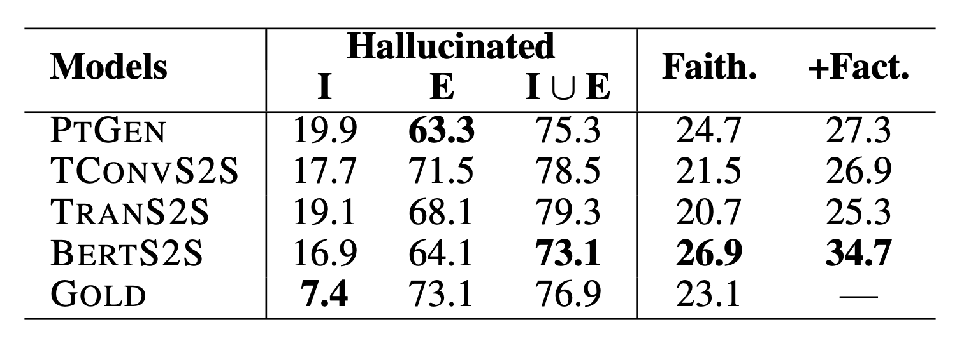
Evaluation of Model Faithfulness and Factuality
Manually annotated intrinsic and extrinsic hallucinations across models
Improvements with BERT-based model

Slide 50
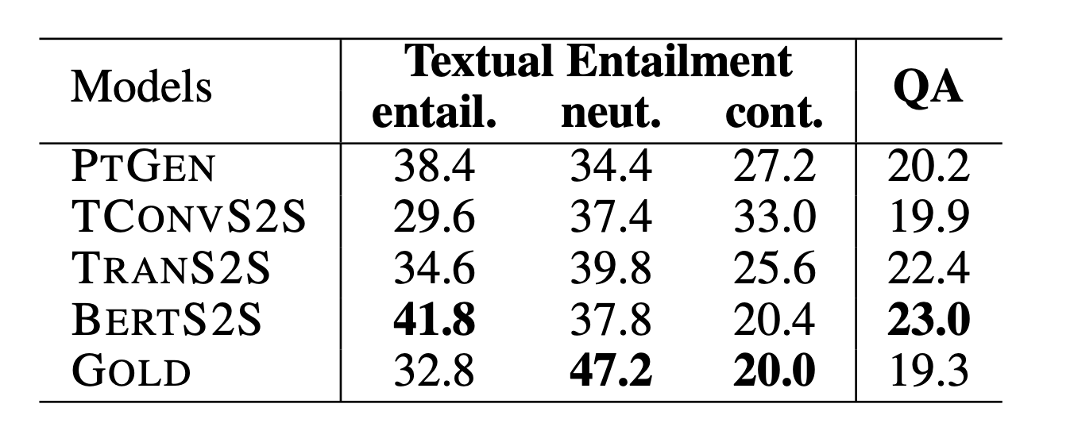
Textual Entailment as a Faithfulness Metric
Use natural language inference (NLI), or whether one text entails another text to determine whether a summary is faithful to the input
Used article as input to NLI model, although this is not optimal
Compare with QA as a metric (generate questions based on the summary, use input document to answer them, use F1 score as metric)

Slide 51
Conclusions
We need to precisely define hallucinations and what is allowable in summary output
Pretrained models improve the faithfulness of the generated output, but there's a long way to go
NLI is a useful metric for faithfulness evaluation
QA has been used a lot recently for faithfulness evaluation and a better comparison with NLI as a metric is needed
FEQA: A Question Answering Evaluation Framework for Faithfulness Assessment in Abstractive Summarization
Asking and Answering Questions to Evaluate the Factual Consistency of Summaries

Slide 52
Discussion Question 1
What characteristics are needed for a summarization dataset/task to be well-defined? In the Newsroom dataset, the summaries vary greatly in terms of how extractive they are from example to example. Is it reasonable to expect a model to learn this variation?

Slide 53
Discussion Question 2
What are the downsides of embedding and question-answering based evaluation metrics and how can they be addressed?

Slide 54
Discussion Question 3
What effect does domain have on summarization evaluation metrics?

Slide 55
Discussion Question 4
How can we improve evaluation metrics of faithfulness to go beyond extractive metrics and also be able to judge very abstractive summaries?

Slide 56
Discussion Question 5
What do you think of the division of hallucinations into intrinsic and extrinsic hallucinations? How should we evaluate plausibile, but not directly stated, model summaries?

Slide 57
Thank you!

Slide 58
References
Abigail See, Peter J. Liu, Christopher D. Manning: Get To The Point: Summarization with Pointer-Generator Networks. ACL (1) 2017: 1073-1083
Alex Kulesza, Ben Taskar: Determinantal Point Processes for Machine Learning. Foundations and Trends in Machine Learning 5(2-3): 123-286 (2012)
Alex Kulesza, Ben Taskar: Learning Determinantal Point Processes. UAI 2011: 419-427
Ani Nenkova, Rebecca J. Passonneau: Evaluating Content Selection in Summarization: The Pyramid Method. HLT-NAACL 2004: 145-152
Arman Cohan, Nazli Goharian: Revisiting Summarization Evaluation for Scientific Articles. LREC 2016
Asli Çelikyilmaz, Antoine Bosselut, Xiaodong He, Yejin Choi: Deep Communicating Agents for Abstractive Summarization. NAACL-HLT 2018: 1662-1675
Avinesh PV, S., Maxime Peyrard, and Christian M. Meyer. "Live Blog Corpus for Summarization." arXiv preprint arXiv:1802.09884 (2018).
Bamman, David, and Noah A. Smith. "New alignment methods for discriminative book summarization." arXiv preprint arXiv:1305.1319 (2013).
Banerjee, Satanjeev and Alon Lavie. “METEOR: An Automatic Metric for MT Evaluation with Improved Correlation with Human Judgments.” IEEvaluation@ACL (2005).
Baumel, T., Eyal, M. and Elhadad, M., 2018. Query focused abstractive summarization: Incorporating query relevance, multi-document coverage, and summary length constraints into seq2seq models. arXiv preprint arXiv:1801.07704.
Carletta, Jean, et al. "The AMI meeting corpus: A pre-announcement." International workshop on machine learning for multimodal interaction. Springer, Berlin, Heidelberg, 2005.
Chen, Yen-Chun, and Mohit Bansal. "Fast abstractive summarization with reinforce-selected sentence rewriting." arXiv preprint arXiv:1805.11080 (2018).
Chu, Eric, and Peter Liu. "MeanSum: a neural model for unsupervised multi-document abstractive summarization." International Conference on Machine Learning. 2019.
Chung, J., Gulcehre, C., Cho, K. & Bengio, Y. (2014). Empirical Evaluation of Gated Recurrent Neural Networks on Sequence Modeling (cite arxiv:1412.3555Comment: Presented in NIPS 2014 Deep Learning and Representation Learning Workshop)
Cohan, Arman, et al. "A discourse-aware attention model for abstractive summarization of long documents." arXiv preprint arXiv:1804.05685 (2018).

Slide 59
References
Diederik P. Kingma, Jimmy Ba: Adam: A Method for Stochastic Optimization. ICLR 2015
Dong, Li, et al. "Unified Language Model Pre-training for Natural Language Understanding and Generation." arXiv preprint arXiv:1905.03197 (2019).
Fabbri, Alexander R., et al. "Multi-News: a Large-Scale Multi-Document Summarization Dataset and Abstractive Hierarchical Model." arXiv preprint arXiv:1906.01749 (2019).
Galgani, Filippo, and Achim Hoffmann. "Lexa: Towards automatic legal citation classification." Australasian Joint Conference on Artificial Intelligence. Springer, Berlin, Heidelberg, 2010.
Ganesan, Kavita, ChengXiang Zhai, and Jiawei Han. "Opinosis: A graph based approach to abstractive summarization of highly redundant opinions." Proceedings of the 23rd International Conference on Computational Linguistics (Coling 2010). 2010.
Ganesan, Kavita. "Rouge 2.0: Updated and improved measures for evaluation of summarization tasks." arXiv preprint arXiv:1803.01937 (2018).
Goodrich, Ben, et al. "Assessing The Factual Accuracy of Generated Text." Proceedings of the 25th ACM SIGKDD International Conference on Knowledge Discovery & Data Mining. ACM, 2019.
Goodrich, Ben, et al. "Assessing The Factual Accuracy of Generated Text." Proceedings of the 25th ACM SIGKDD International Conference on Knowledge Discovery & Data Mining. ACM, 2019.
Grenander, Matt, et al. "Countering the Effects of Lead Bias in News Summarization via Multi-Stage Training and Auxiliary Losses." arXiv preprint arXiv:1909.04028 (2019).
Grusky, Max, Mor Naaman, and Yoav Artzi. "Newsroom: A dataset of 1.3 million summaries with diverse extractive strategies." arXiv preprint arXiv:1804.11283 (2018).
Günes Erkan, Dragomir R. Radev: LexRank: Graph-based Lexical Centrality as Salience in Text Summarization. J. Artif. Intell. Res. 22: 457-479 (2004)
Hsu, Wan-Ting, et al. "A unified model for extractive and abstractive summarization using inconsistency loss." arXiv preprint arXiv:1805.06266 (2018).
Hui Lin, Jeff A. Bilmes: A Class of Submodular Functions for Document Summarization. ACL 2011: 510-520
Hui Lin, Jeff A. Bilmes: A Class of Submodular Functions for Document Summarization. ACL 2011: 510-520
Jaime G. Carbonell, Jade Goldstein: The Use of MMR, Diversity-Based Reranking for Reordering Documents and Producing Summaries. SIGIR 1998: 335-336

Slide 60
References
Jeffrey Pennington, Richard Socher, Christopher D. Manning: Glove: Global Vectors for Word Representation. EMNLP 2014: 1532-1543
Jordan J Louviere, Terry N Flynn, and Anthony Alfred John Marley. 2015. Best-worst scaling: Theory, methods and applications. Cambridge University Press.
Karl Moritz Hermann, Tomás Kociský, Edward Grefenstette, Lasse Espeholt, Will Kay, Mustafa Suleyman, Phil Blunsom: Teaching Machines to Read and Comprehend. NIPS 2015: 1693-1701
Kedzie, Chris, Kathleen McKeown, and Hal Daume III. "Content selection in deep learning models of summarization." arXiv preprint arXiv:1810.12343 (2018).
Kim, Byeongchang, Hyunwoo Kim, and Gunhee Kim. "Abstractive Summarization of Reddit Posts with Multi-level Memory Networks." arXiv preprint arXiv:1811.00783 (2018).
Kornilova, Anastassia, and Vlad Eidelman. "BillSum: A Corpus for Automatic Summarization of US Legislation." arXiv preprint arXiv:1910.00523 (2019).
Koupaee, Mahnaz, and William Yang Wang. "WikiHow: A Large Scale Text Summarization Dataset." arXiv preprint arXiv:1810.09305 (2018).
Kryściński et al., 2019. “Evaluating the Factual Consistency of Abstractive Text Summarization.” arXiv preprint arXiv:1910.12840 (2019).
Kryściński, Wojciech, et al. "Neural text summarization: A critical evaluation." arXiv preprint arXiv:1908.08960 (2019).
Lebanoff, L., Song, K. and Liu, F., 2018. Adapting the neural encoder-decoder framework from single to multi-document summarization. EMNLP 2018.
Lin, Chin-Yew. “ROUGE: A Package For Automatic Evaluation Of Summaries.” ACL 2004 (2004).
Liu, Peter J., Yu-An Chung, and Jie Ren. "SummAE: Zero-Shot Abstractive Text Summarization using Length-Agnostic Auto-Encoders." arXiv preprint arXiv:1910.00998 (2019).
Liu, Peter J., et al. "Generating wikipedia by summarizing long sequences." arXiv preprint arXiv:1801.10198 (2018).
Liu, Yang, and Mirella Lapata. "Hierarchical Transformers for Multi-Document Summarization." arXiv preprint arXiv:1905.13164 (2019).
Liu, Yang, and Mirella Lapata. "Text summarization with pretrained encoders." arXiv preprint arXiv:1908.08345 (2019).

Slide 61
References
Liu, Yang. "Fine-tune BERT for Extractive Summarization." arXiv preprint arXiv:1903.10318 (2019).
Mani, Inderjeet, and M. T. Maybury. "Advances in automated text summarization." (1999): 442p.
Marc'Aurelio Ranzato, Sumit Chopra, Michael Auli, Wojciech Zaremba: Sequence Level Training with Recurrent Neural Networks. ICLR 2016 maintained by Schloss Dagstuhl LZI, founded at University of Trier
Matthew E. Peters, Mark Neumann, Mohit Iyyer, Matt Gardner, Christopher Clark, Kenton Lee, Luke Zettlemoyer: Deep Contextualized Word Representations. NAACL-HLT 2018: 2227-2237
Mike Lewis, Yinhan Liu, Naman Goyal, Marjan Ghazvininejad, Abdelrahman Mohamed, Omer Levy, Ves Stoyanov, Luke Zettlemoyer. “BART: Denoising Sequence-to-Sequence Pre-training for Natural Language Generation, Translation, and Comprehension.” arXiv prepring arXiv:1910.13461 (2019).
Narayan, Shashi, Shay B. Cohen, and Mirella Lapata. "Don't Give Me the Details, Just the Summary! Topic-Aware Convolutional Neural Networks for Extreme Summarization." arXiv preprint arXiv:1808.08745 (2018).
Ng, Jun-Ping, and Viktoria Abrecht. "Better summarization evaluation with word embeddings for rouge." arXiv preprint arXiv:1508.06034 (2015).
Perez-Beltrachini, Laura, Yang Liu, and Mirella Lapata. "Generating Summaries with Topic Templates and Structured Convolutional Decoders." arXiv preprint arXiv:1906.04687 (2019).
Peyrard, Maxime. "Studying Summarization Evaluation Metrics in the Appropriate Scoring Range." Proceedings of the 57th Annual Meeting of the Association for Computational Linguistics. 2019.
Rada Mihalcea, Paul Tarau: TextRank: Bringing Order into Text. EMNLP 2004: 404-411
Raffel, Colin, et al. "Exploring the Limits of Transfer Learning with a Unified Text-to-Text Transformer." arXiv preprint arXiv:1910.10683 (2019).
Ramakrishna Vedantam, C. Lawrence Zitnick, Devi Parikh: CIDEr: Consensus-based image description evaluation. CVPR 2015: 4566-4575
Ramesh Nallapati, Bowen Zhou, Cícero Nogueira dos Santos, Çaglar Gülçehre, Bing Xiang: Abstractive Text Summarization using Sequence-to-sequence RNNs and Beyond. CoNLL 2016: 280-290
Ramesh Nallapati, Feifei Zhai, Bowen Zhou: SummaRuNNer: A Recurrent Neural Network Based Sequence Model for Extractive Summarization of Documents. AAAI 2017: 3075-3081
Ratish Puduppully, Li Dong, Mirella Lapata: Data-to-Text Generation with Content Selection and Planning. CoRR abs/1809.00582 (2018)

Slide 62
References
Richard S. Sutton, David A. McAllester, Satinder P. Singh, Yishay Mansour: Policy Gradient Methods for Reinforcement Learning with Function Approximation. NIPS 1999: 1057-1063
Romain Paulus, Caiming Xiong, Richard Socher: A Deep Reinforced Model for Abstractive Summarization. ICLR 2018
Ronald J. Williams: Simple Statistical Gradient-Following Algorithms for Connectionist Reinforcement Learning. Machine Learning 8: 229-256 (1992) 1990
Rush, Alexander M., Sumit Chopra, and Jason Weston. "A neural attention model for abstractive sentence summarization." arXiv preprint arXiv:1509.00685 (2015).
Sandhaus, Evan. The New York Times Annotated Corpus LDC2008T19. DVD. Philadelphia: Linguistic Data Consortium, 2008.
Sebastian Gehrmann, Yuntian Deng, Alexander M. Rush: Bottom-Up Abstractive Summarization. EMNLP 2018: 4098-4109
Sepp Hochreiter, Jürgen Schmidhuber: Long Short-Term Memory. Neural Computation 9(8): 1735-1780 (1997) maintained by Schloss Dagstuhl LZI, founded at University of Trier
ShafieiBavani, Elaheh, et al. "A Graph-theoretic Summary Evaluation for ROUGE." Proceedings of the 2018 Conference on Empirical Methods in Natural Language Processing. 2018.
Sharma, Eva, Chen Li, and Lu Wang. "BIGPATENT: A Large-Scale Dataset for Abstractive and Coherent Summarization." arXiv preprint arXiv:1906.03741 (2019).
Shashi, Narayan, and Andreas Vlachos. "HighRES: Highlight-based Reference-less Evaluation of Summarization." (2019).
Song, Kaitao, et al. "Mass: Masked sequence to sequence pre-training for language generation." arXiv preprint arXiv:1905.02450 (2019).
Steven J. Rennie, Etienne Marcheret, Youssef Mroueh, Jarret Ross, Vaibhava Goel: Self-Critical Sequence Training for Image Captioning. CVPR 2017: 1179-1195
Svetlana Kiritchenko, Saif Mohammad: Best-Worst Scaling More Reliable than Rating Scales: A Case Study on Sentiment Intensity Annotation. ACL (2) 2017: 465-470
Tomas Mikolov, Ilya Sutskever, Kai Chen, Gregory S. Corrado, Jeffrey Dean: Distributed Representations of Words and Phrases and their Compositionality. NIPS 2013: 3111-3119
Ulrich, Jan, Gabriel Murray, and Giuseppe Carenini. "A publicly available annotated corpus for supervised email summarization." Proc. of aaai email-2008 workshop, chicago, usa. 2008.

Slide 63
References
Vincent, Pascal, et al. "Extracting and composing robust features with denoising autoencoders." Proceedings of the 25th international conference on Machine learning. ACM, 2008.
Xingxing Zhang, Furu Wei, Ming Zhou. “HIBERT: Document Level Pre-training of Hierarchical Bidirectional Transformers for Document Summarization.” arXiv preprint arXiv:1905.06566 (2019).
Yasunaga, Michihiro, et al. "Graph-based neural multi-document summarization." arXiv preprint arXiv:1706.06681 (2017).
Yasunaga, Michihiro, et al. "ScisummNet: A large annotated corpus and content-impact models for scientific paper summarization with citation networks." Proceedings of the AAAI Conference on Artificial Intelligence. Vol. 33. 2019.
Yonghui Wu, Mike Schuster, Zhifeng Chen, Quoc V. Le, Mohammad Norouzi, Wolfgang Macherey, Maxim Krikun, Yuan Cao, Qin Gao, Klaus Macherey, Jeff Klingner, Apurva Shah, Melvin Johnson, Xiaobing Liu, Lukasz Kaiser, Stephan Gouws, Yoshikiyo Kato, Taku Kudo, Hideto Kazawa, Keith Stevens, George Kurian, Nishant Patil, Wei Wang, Cliff Young, Jason Smith, Jason Riesa, Alex Rudnick, Oriol Vinyals, Greg Corrado, Macduff Hughes, Jeffrey Dean: Google's Neural Machine Translation System: Bridging the Gap between Human and Machine Translation. CoRR abs/1609.08144 (2016)
Yue Dong, Yikang Shen, Eric Crawford, Herke van Hoof, Jackie Chi Kit Cheung: BanditSum: Extractive Summarization as a Contextual Bandit. EMNLP 2018: 3739-3748
Zhang, J., Tan, J. and Wan, X., 2018. Towards a neural network approach to abstractive multi-document summarization. arXiv preprint arXiv:1804.09010.
Zhang, Rui, and Joel Tetreault. "This Email Could Save Your Life: Introducing the Task of Email Subject Line Generation." arXiv preprint arXiv:1906.03497 (2019).
Zhang, Weiwei, Jackie Chi Kit Cheung, and Joel Oren. "Generating Character Descriptions for Automatic Summarization of Fiction." Proceedings of the AAAI Conference on Artificial Intelligence. Vol. 33. 2019.
Zhong, Ming, et al. "Searching for Effective Neural Extractive Summarization: What Works and What's Next." arXiv preprint arXiv:1907.03491 (2019).
Zheng, Hao, and Mirella Lapata. "Sentence centrality revisited for unsupervised summarization." arXiv preprint arXiv:1906.03508 (2019).
Zhang, Jingqing, et al. "Pegasus: Pre-training with extracted gap-sentences for abstractive summarization." arXiv preprint arXiv:1912.08777 (2019).
Zhao, Yao, Mohammad Saleh, and Peter J. Liu. "SEAL: Segment-wise Extractive-Abstractive Long-form Text Summarization." arXiv preprint arXiv:2006.10213 (2020).

